Slide 1
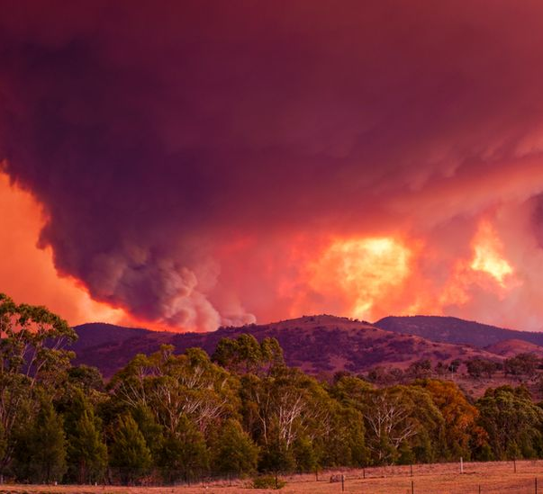
Data analysis and visualization on Australian bushfire 2019-2020
Hyun jeon
Notes:
Hello. This presentation is data analysis and visualization on Australian bush fire that has occurred during summer of 2019 to 2020.

Slide 2
Australia fire 2019-2020
Massive fire
Worst in recent times
Started from early November 2019 to February 2020
Peak at late December to early January 2020
From Victoria to gradually
Western Australia
South Australia
Australian Capital Territory
Queensland
New South Wales
Notes:
The 2019-2020 was a massive fire, that was worst in recent times. Started
From

Slide 3
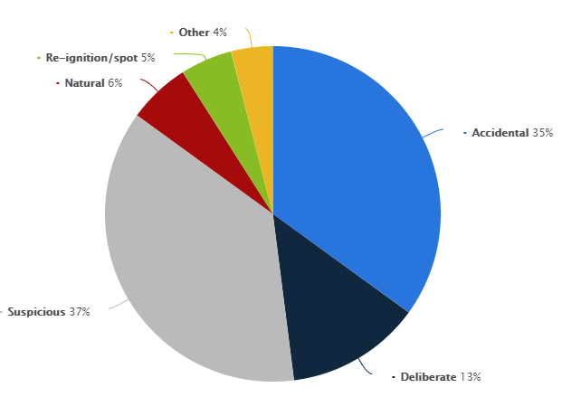
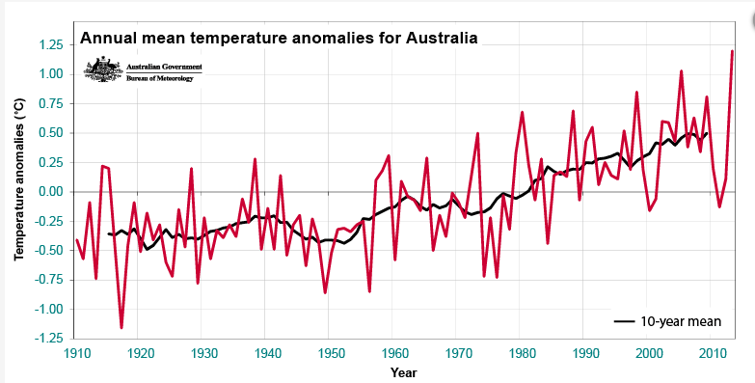
General statistics
Notes:
General statistics. Fires records until 2019, show natural fire is only 6% and usually accidental. Suspicious may contain some natural fire, but unsure.
From Beaureau of Meteoloroly it does show annual mean temperature anomalies gradually increased until 2019.

Slide 4
Background of this research
Unclear what has caused the fire exactly
Natural fire?
From heat
From thunder
Human?
Most feasible theory is that it has been caused by heat from global warming
Notes:
Why this topic was chosen. Unclear … Natural fire is most feasible theory. Due to global warming. Probably from heat or maybe thunder. There can be human fire

Slide 5
aim
Find out whether climate has correlation to the fire
Temperature
Solar Exposure
Rainfall
Notes:
Aim

Slide 6
data
Fire Data
From NASA
By Satellite VIIRS sensor
Climate Data
From BOM
Temperature
Rainfall
Solar Exposure
5 main cities
Brisbane
Sydney
Melbourne
Perth
Adelaide
From 1st of October 2019 to 11th of February 2020
Month before
Till the peak times
Notes:
Visible Infrared Imaging Radiometer Suite which collected radioactive data with infrared.
Data before to see what caused, warming up? Data after the peak is meaningless to what caused or affected fire

Slide 7
Data processing and clean up
Processed to clean up
Remove unnecessary
Remove null/NA
Merge
Notes:
Dat has been processed and cleaned up for actual proper data to be used. Any abnormal data can make interpretation wrong. Removing null, some data were filled with average. Merge to view in a whole

Slide 8
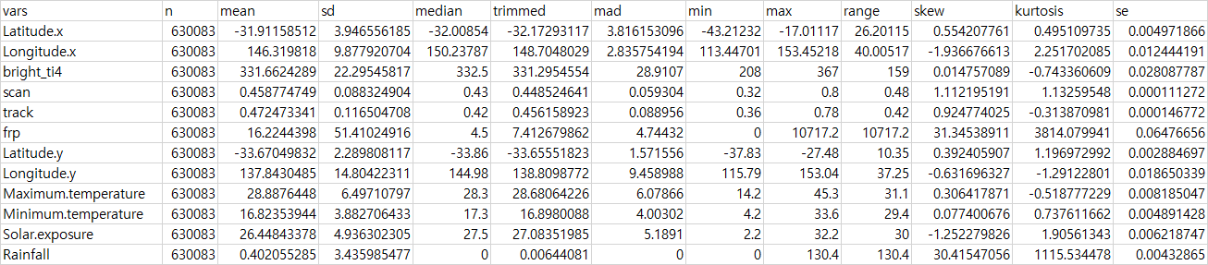
General eda – description of data
Notes:
After clean up total 630083 datas. Mean maximum temp 28, mean minimum 16, mean rainfall. Median close to 0

Slide 9
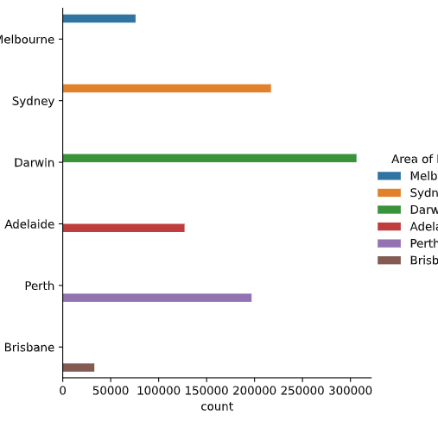
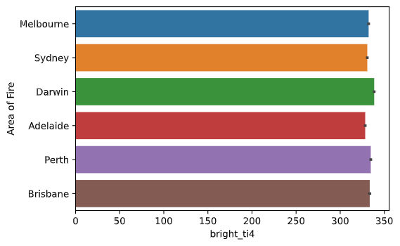
Eda - fire
Notes:
Fire most in Darwin least in Brisbane. Brightness = strength similar generally Darwin top and Adelaide least probs due to beiung cloe to equator

Slide 10
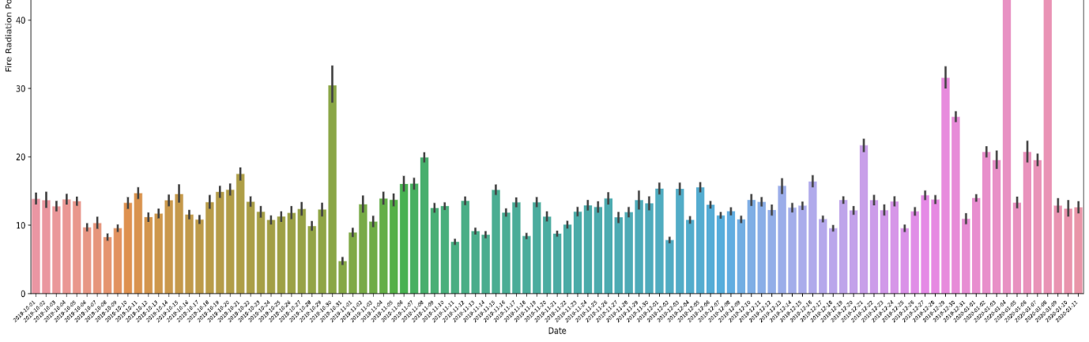
Time line of fire
Notes:
Timeline of fire

Slide 11
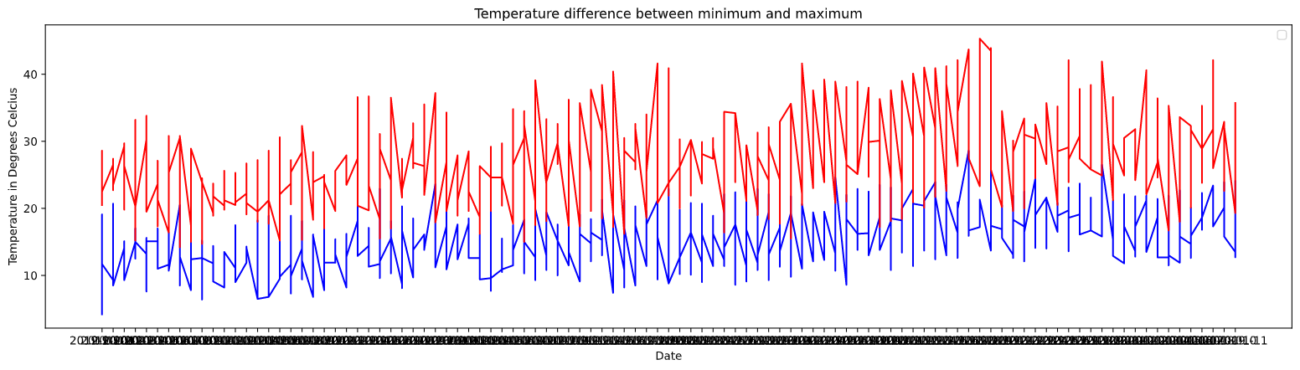
EDA - Temperature

Slide 12
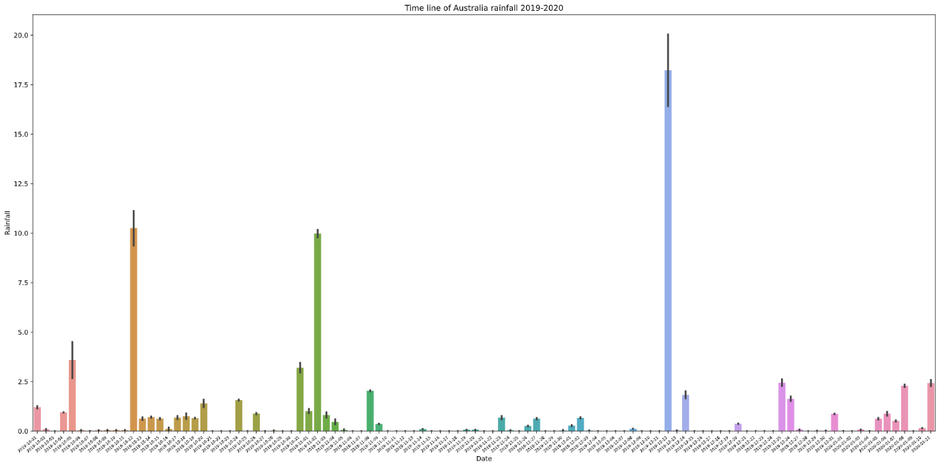
Timeline of rainfall

Slide 13
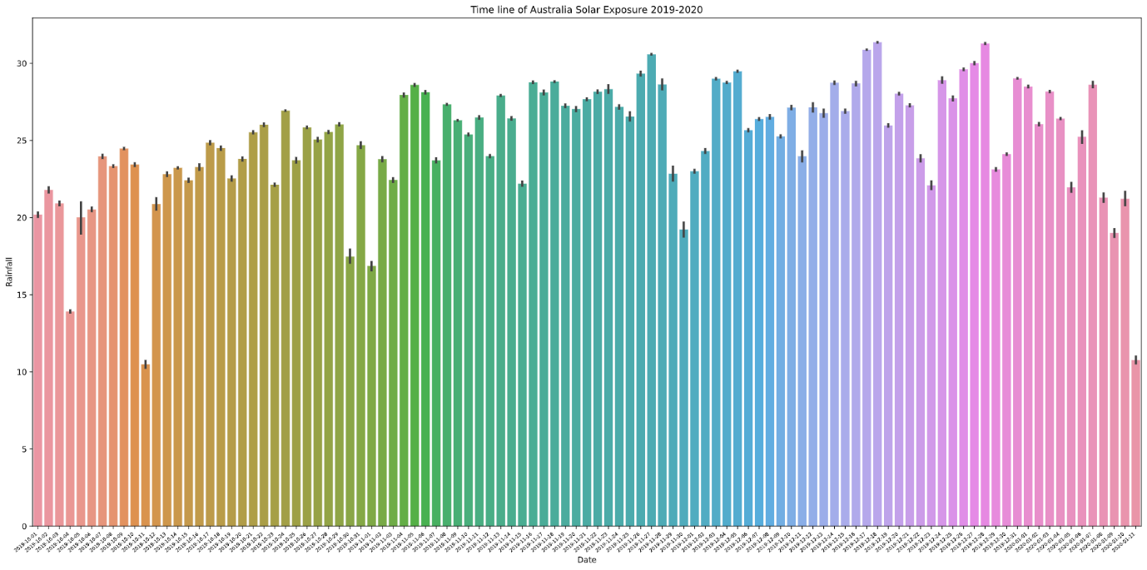
Timeline of solar exposure

Slide 14
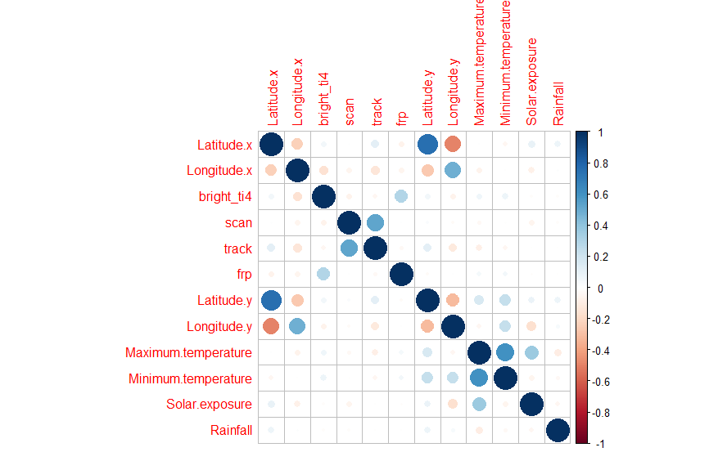
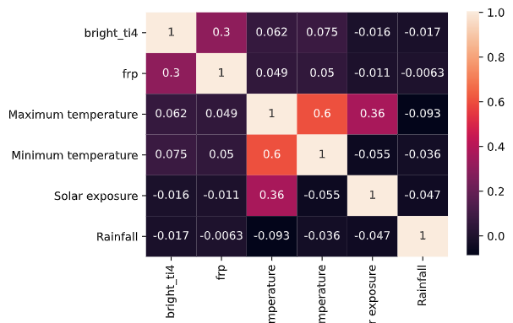
Correlation
Notes:
Correlation. Not much found. Obvious solar-temperature, other thatn that no real big correlation found

Slide 15
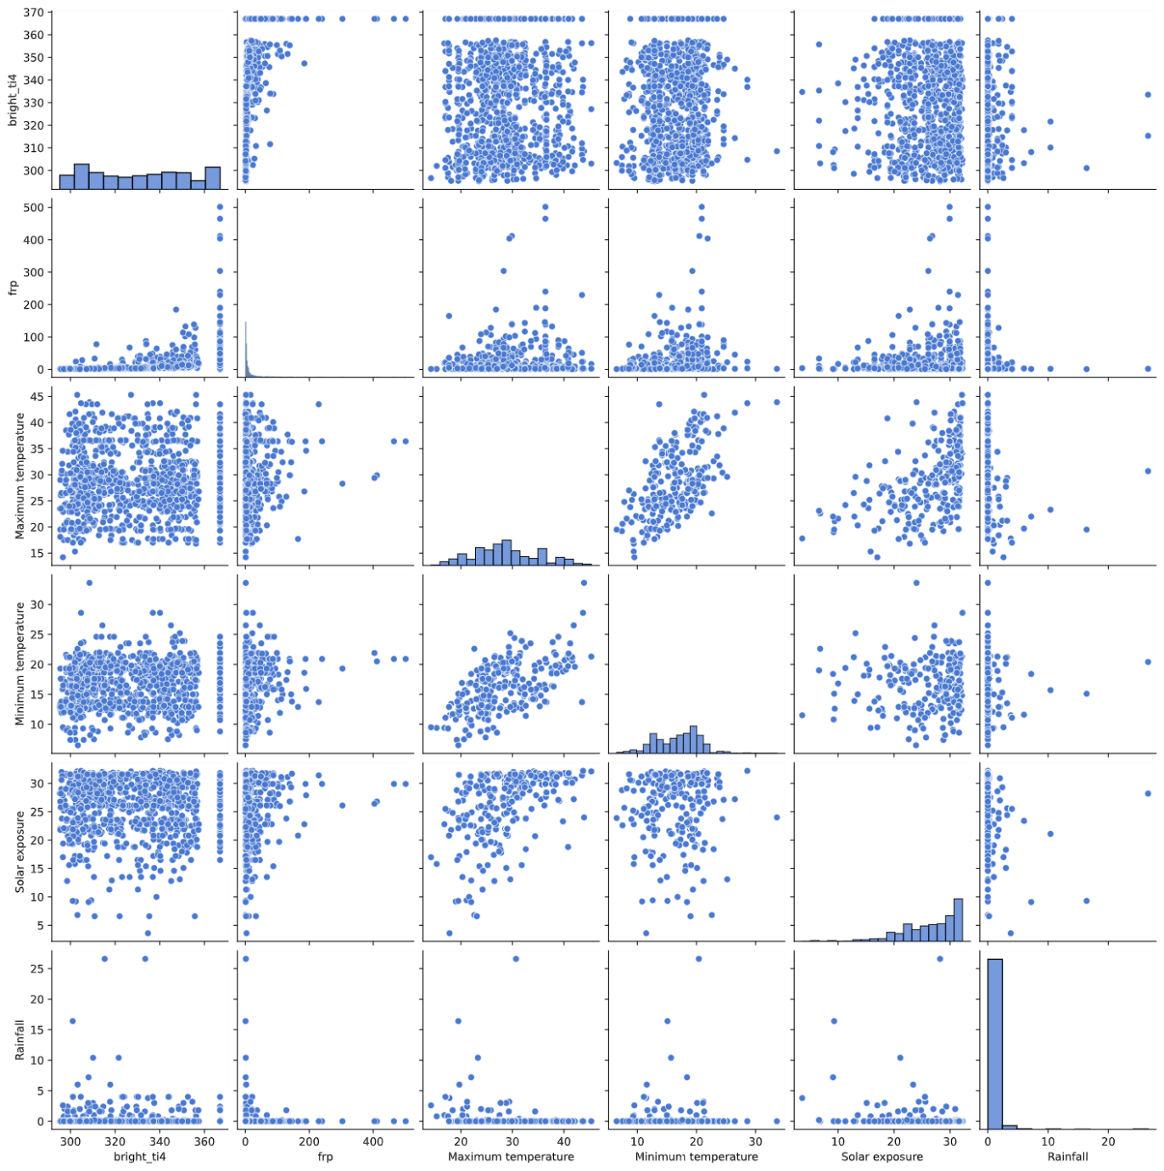
pairplot
Notes:
Pairplot done with data randomly sampled from 630 000 data. Not too much relation could be found. Just very scattered.

Slide 16
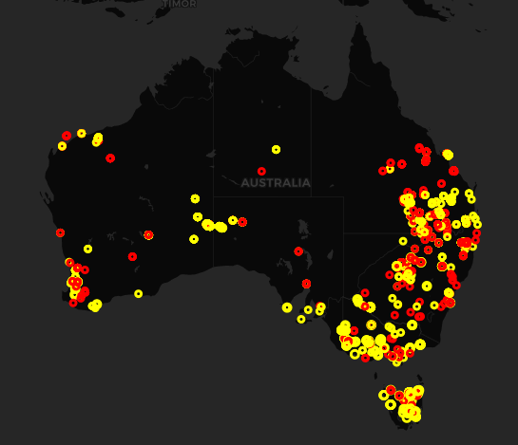
Maps - fire
Notes:
Brightness over 325 is red – close to mean/median

Slide 17
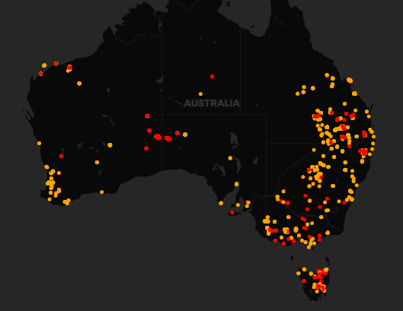
Maps – solar exposure
Notes:
Solar exposure higher than 20 mean/median

Slide 18
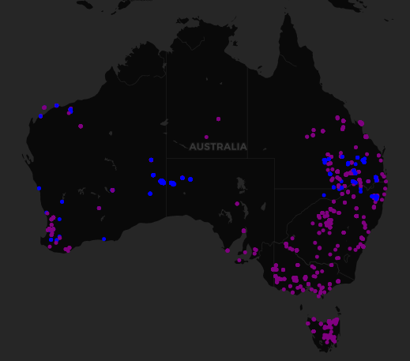
Maps - rainfall
Notes:
Rainfall higher than 1 – meaningful precipitation

Slide 19
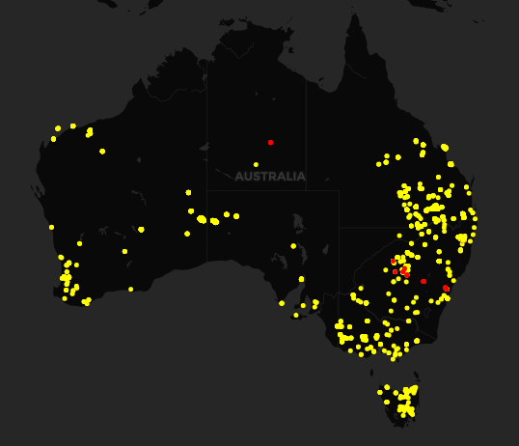
Maps – Max Temperature
Notes:
Max temp higher than 35, meaningful

Slide 20
discussion
Correlation does not show much relationship between each data
01
Maps show somewhat relationship
02
Not significantly hotter than previous years
03

Slide 21
limitation
Difficult to obtain data
Not refined data
Lots of missing data
Human error
Mechanical fault
Fire data not exact
From light sensor in satellite up in sky

Slide 22
Improvement
Historical data
Compare
More sets of data

Slide 23
conclusion
Can not say for sure that climate has affected fire much with current data
Even the climate did, it can not explain such huge size fire compared to previous years

